Slide 1
Image Kings - AWS Training
Team Members:
Vikram Eleti > United Airlines
Alex Hirsbrunner > Nokia Networks
Ronie Lima > McDonalds
Mohammed Petiwala > Nokia Networks
Jesse Rau > United Airlines

Slide 2
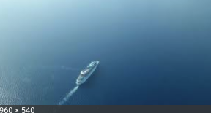
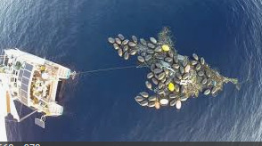
Image Kings - Project Goals
Have Fun, Work in Moderation, Don’t Fail (more on this later…)
Train a SageMaker semantic segmentation model to predict if and where one or more ships are located, given a 768 x 768 pixel .jpg as input.
- The image data set is pre-provided by Airbus
Determine if we can predict ship presence and location using random Google images of the ocean (not provided by Airbus) e.g.:

Slide 3
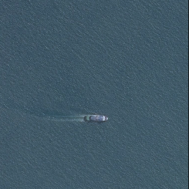
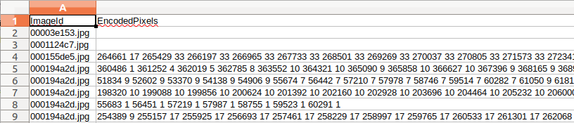
Image Kings – ETL Strategy* *selected in part due to the use of semantic segmentation
The data for our project is part of a competition using Airbus provided aerial images of sections of the ocean (which may contain ships)
The data is provided in two forms
A .jpg of the image with/without a ship present
A .csv file that includes RLE encoded representations of ground truth with respect to where a given ship is in the corresponding .jpg.

Slide 4
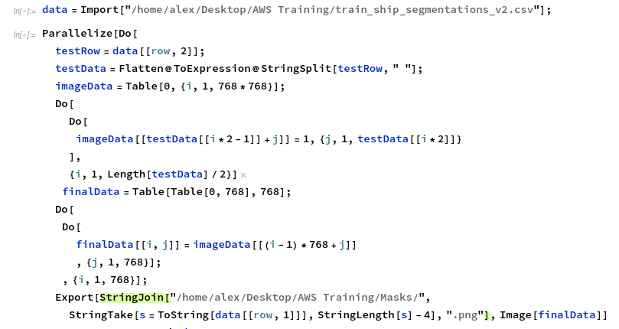

Image Kings – ETL Strategy (cont.)
The RLE data representing the ground truth needs to be converted into a .png bit mask where black pixels = notShip (0) and white pixels = ship (255) – there are 200K + images and masks to use.
Basically this:
Example .png:

Slide 5
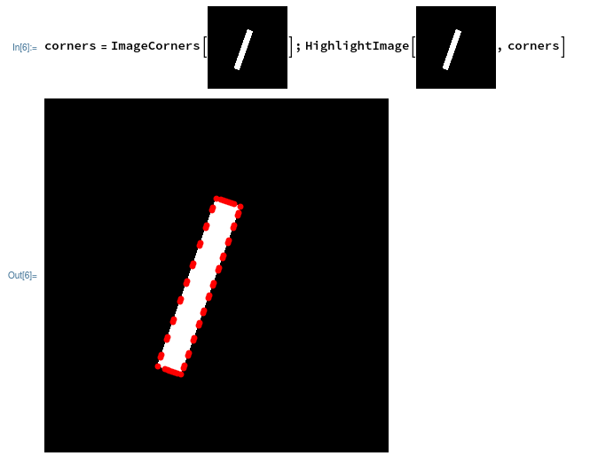
Image Kings – ETL Strategy (cont.)
Split the existing training set into two since the test data does not have any corresponding .csv file.
80% training 20% validation
The output of the NN on new data will be a segmented .png analogous to the training .pngs
Extra credit is to find the bounding polygon
Pick the 4 red points that contain min x, min y, max x, max y to create the bounding polygon

Slide 6
Image Kings – Modeling strategy
Use Amazon SageMaker Semantic Segmentation Algorithm Notebook
https://rl1.notebook.us-east-1.sagemaker.aws/notebooks/semantic_segmentation_pascalvoc_2019-01-10/semantic_segmentation_pascalvoc.ipynb
Retrain resnet50 CNN (set in hyperparameters) with ocean/ship .jpgs and .png mask as input data points.
Optimizer RMSProp (set in hyperparameters)
Using ml.p3.16xlarge

Slide 7
Image Kings – Training
Original 26 GB of .jpg data was too large to download from S3 to EC2 in a reasonable amount of time during training.
Trimmed the data down to 15% of the original data set and restarted training
Had to increase class count from 2 to 226 to account for white pixels of image mask being set to 225 (instead of 1)
Internal Server Errors could not be overcome during the afternoon once we started training.

Slide 8
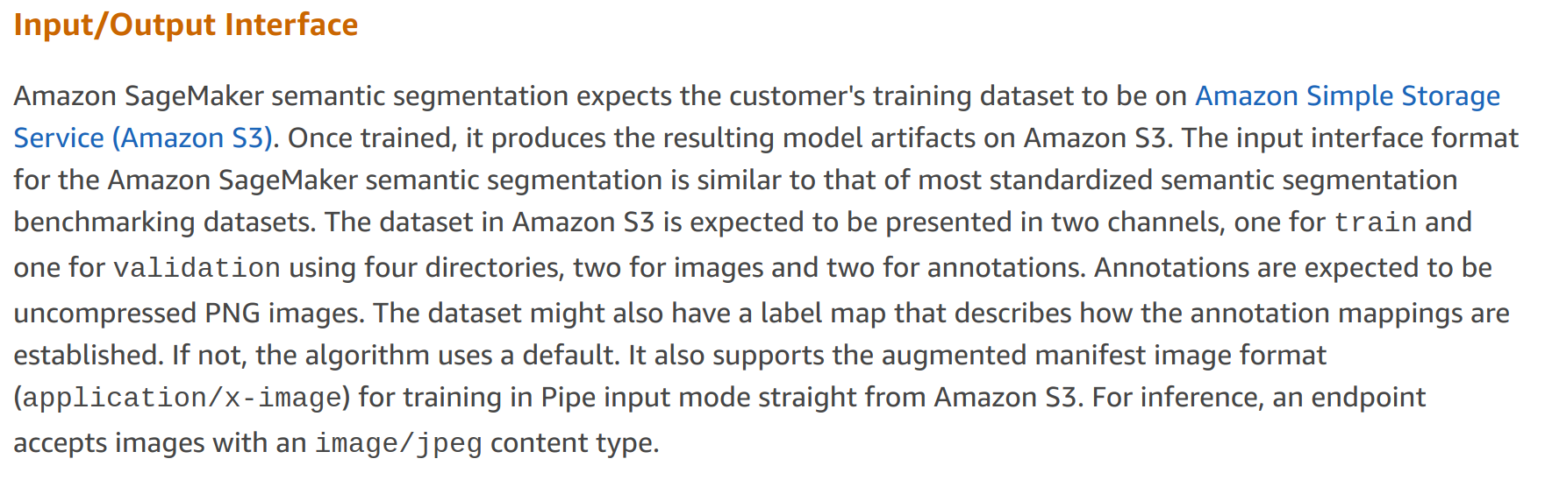
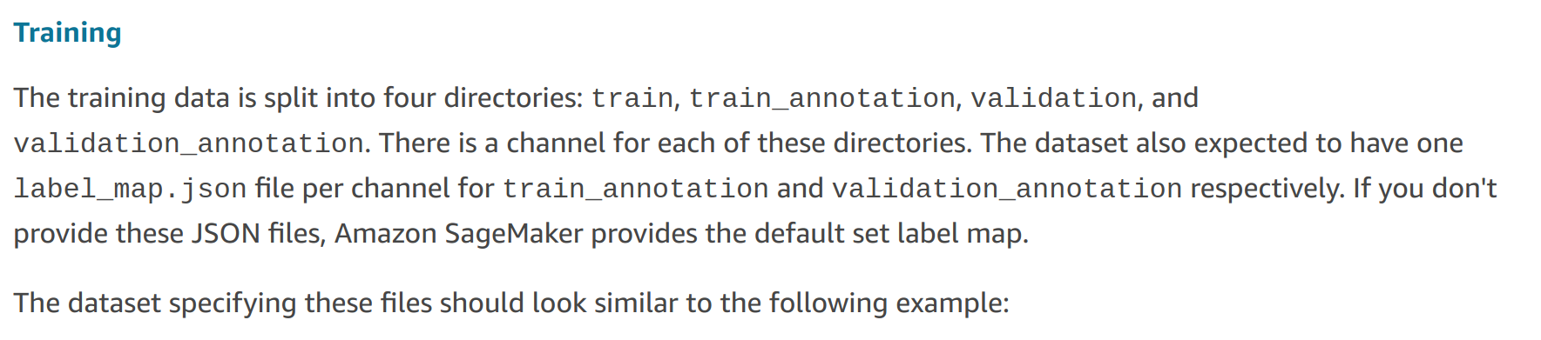
Image Kings - What went wrong…?

Slide 9
Image Kings – Goals for going into production
Deployed System Architecture:
New .jpg ocean/ship images
Lambda (image ingestion and conversion of .jpg to byte array
Deployed instance for inference (ml.c4.xlarge)
Lambda (bounding box calculation)
Hosted DB (new ship locations – bounding rectangles/date of photo as key

Slide 10
Image Kings – Conclusion
We actually learned more by failing as we ended up explored both the object recognition and semantic segmentation
Since we have two sets of two people working at Nokia and United respectively, we will both be trying to get this working after the training.
Considering renaming team to “Burger Kings”

